Slide 1
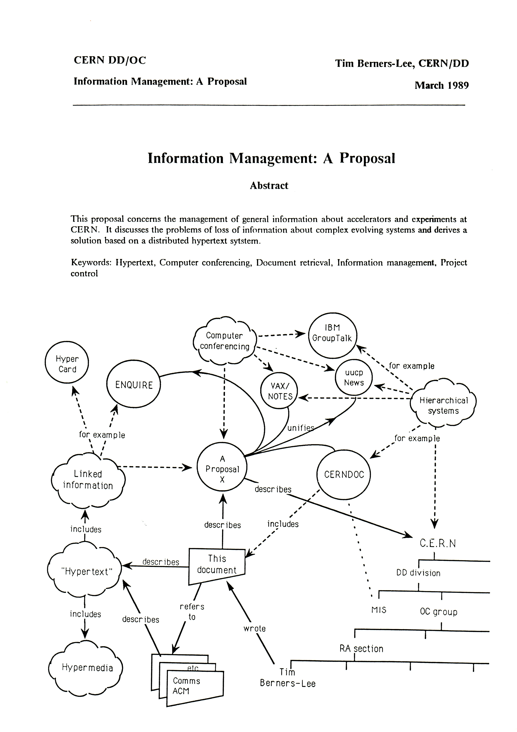
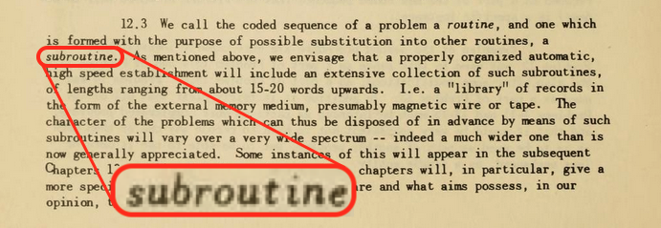
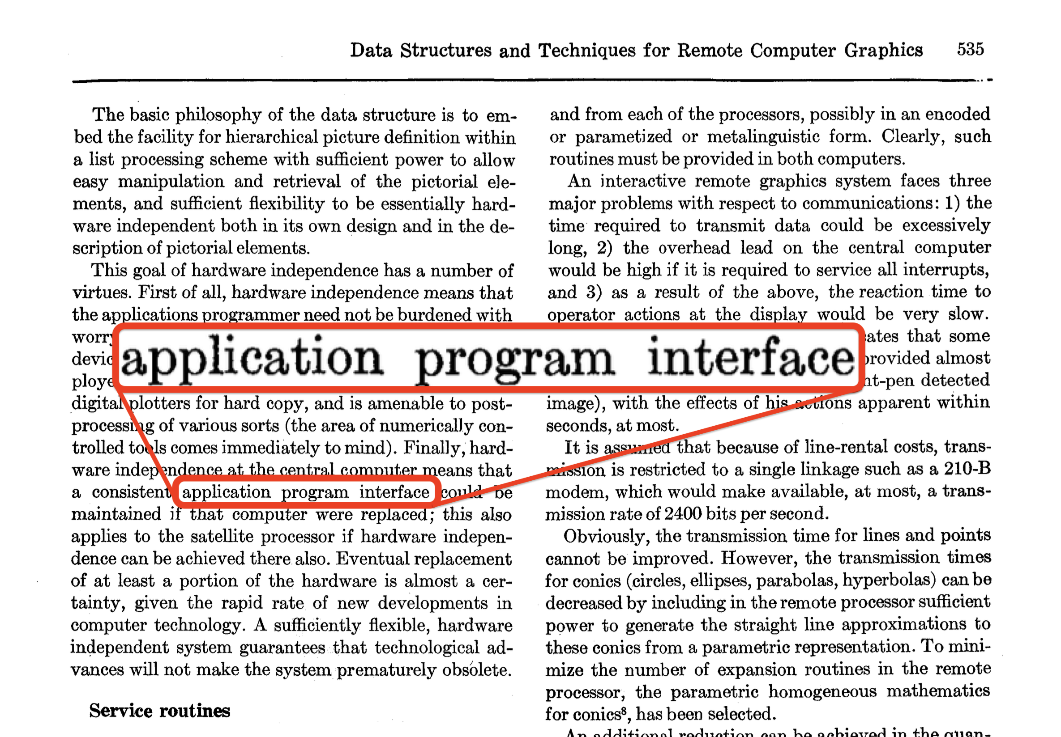
1947
"Subroutine"
1968
"API"
1989
"Web" & HTTP

Slide 2
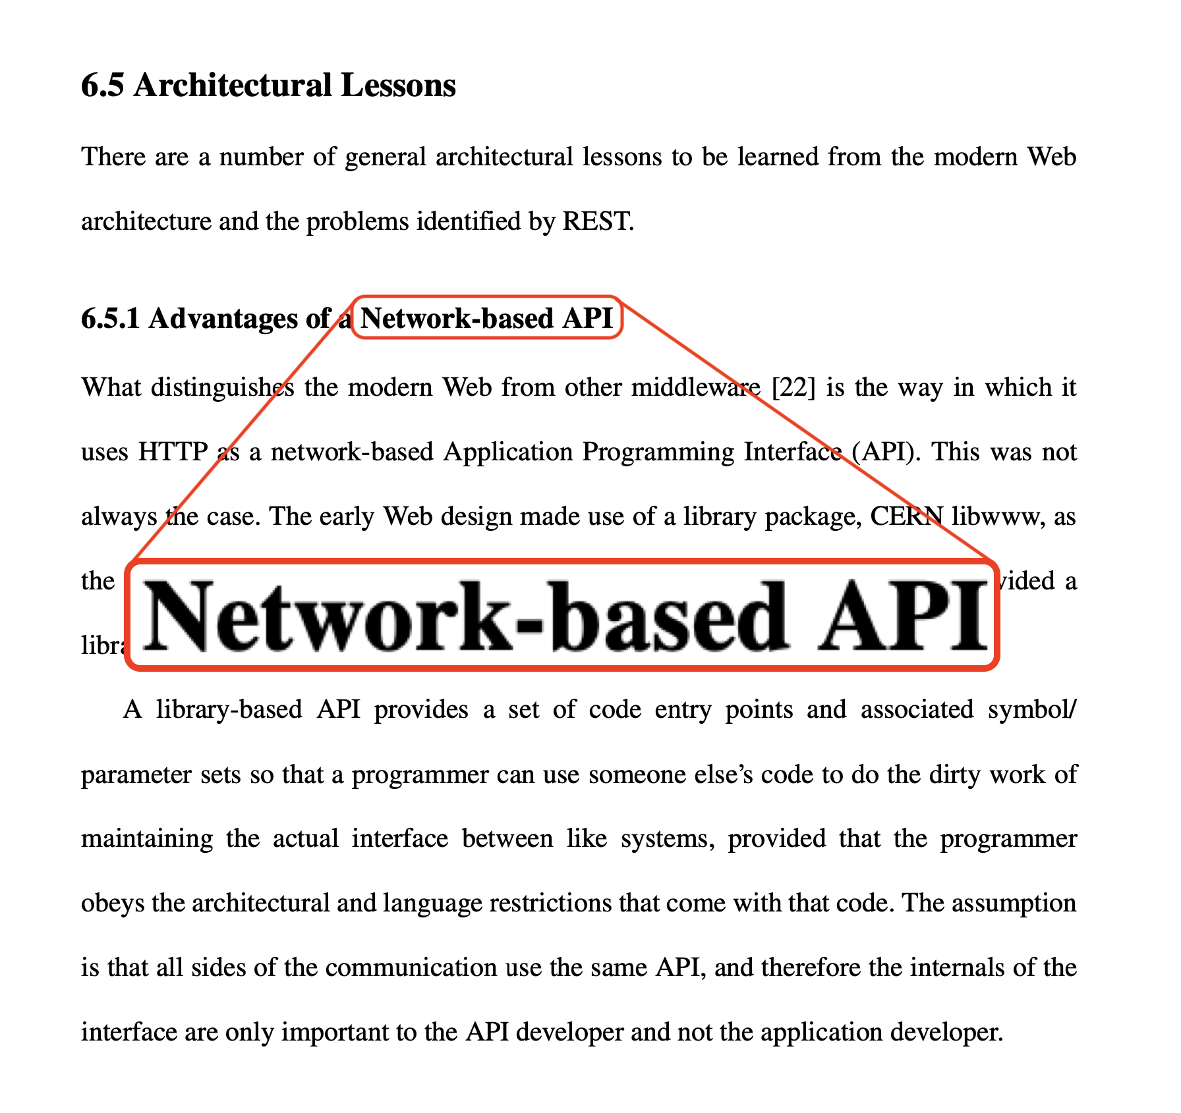

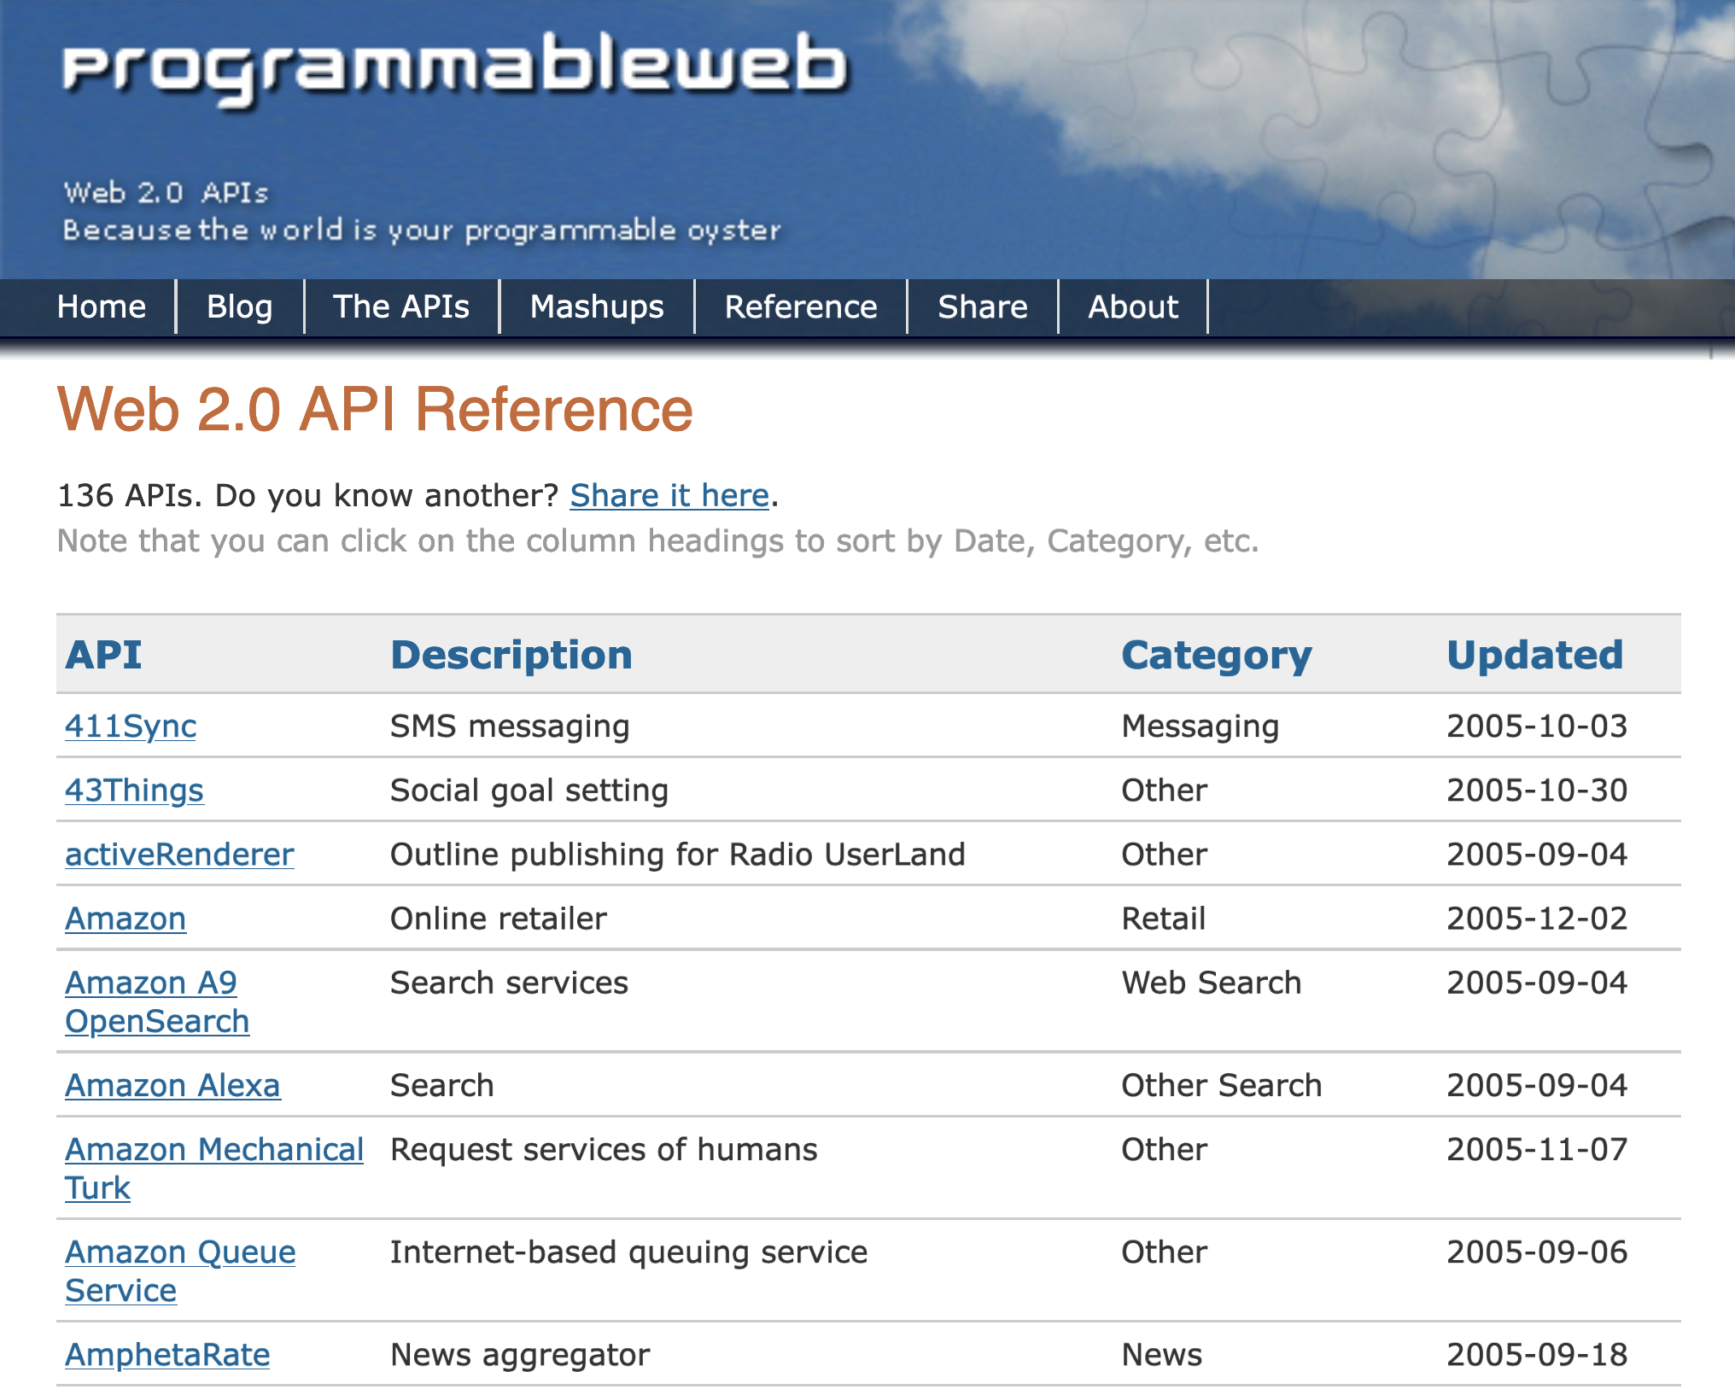
Ende 1990er
"World Wide Web"
2000
"Network-based API"
Anfang 2000er
"Web APIs"

Slide 3




2010
OpenAPI
2012
GraphQL
2015
gRPC
2016
AsyncAPI

Slide 4
1947
1968
1989
1990er
2000
2000er
2010
2012
2015
2016

